Slide 1
Comprehensive Report
For Senior Bank Managers

Slide 2
01
02
Introduction The objective of this analysis is to examine and select the best prediction model for loan outcomes. Customer data, including financial profiles, repayment history, and related factors, are analyzed to make the best decisions regarding loans.
Key Findings and Model Comparison A comparison of five models (Random Forest, XGBoost, Logistic Regression, and ANN) has been carried out. These models have been evaluated based on the following metrics:
Error Rate
F1-Score
03
False Positive Rate

Slide 3
01
Model Comparison
Why we choose Ann over other algorithm ?
You can enter a subtitle here if you need it

Slide 4
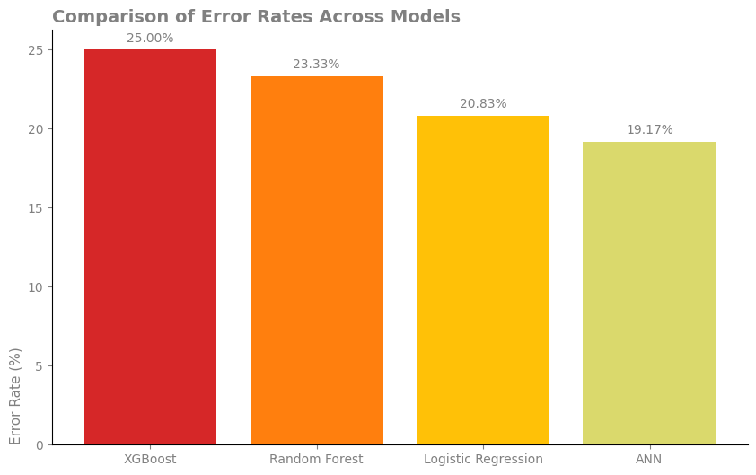
Error Rate :

Slide 5
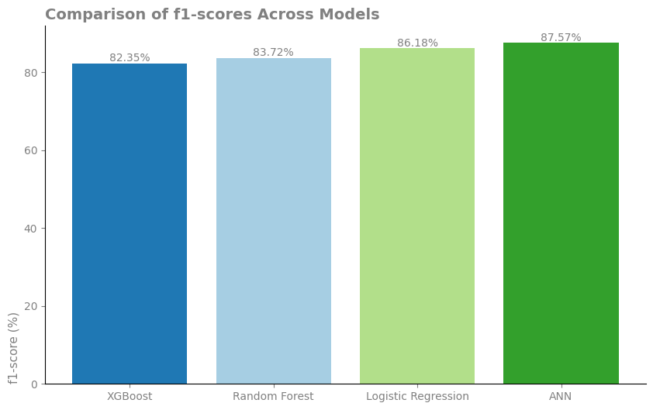
F1 – Score :

Slide 6
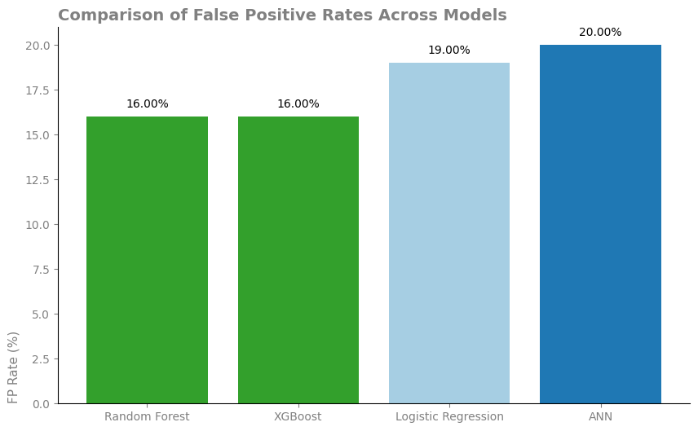
False Positive Rate:

Slide 7
Results :
------------------------------------------------------
The best model in terms of accuracy and the lowest error rate is the Artificial Neural Networks (ANN).
Logistic Regression is a suitable model requiring fewer resources while still offering high accuracy.
It is recommended to use the ANN model as the primary model and Logistic Regression as an alternative model.

Slide 8
The Impact of The Model
Truth behind using Ai and machine learning models

Slide 9
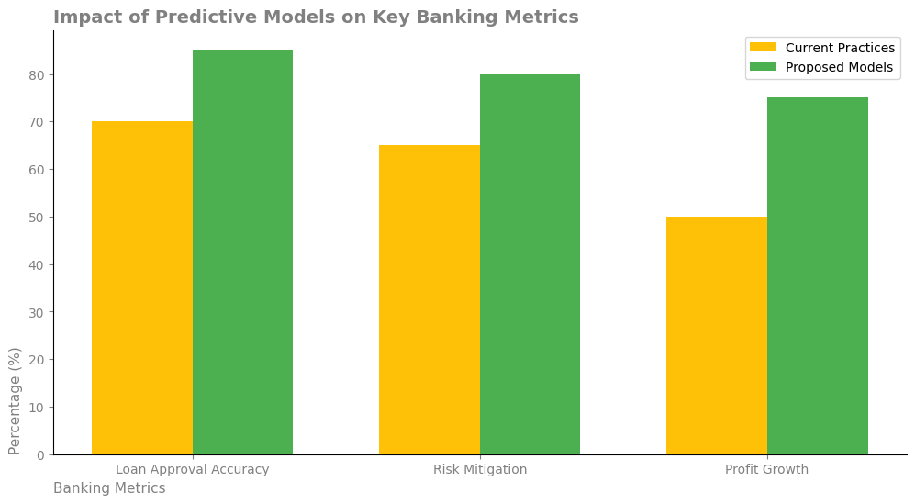
Impact of Models on Key Bank Metrics
This chart compares the performance of the bank's current systems with the predicted results after implementing the proposed models.
Three key metrics displayed:
Loan Approval Accuracy: Improvement from 70% to 85%, indicating the enhanced ability of models to identify eligible customers.
Risk Management: Reduced risk through precise prediction of high-risk customers, improving financial security from 65% to 80%.
Profit Growth: Identifying reliable customer profiles has increased profitability from 50% to 75%.
Key Message: Investing in these AI models strengthens data-driven decision-making, ultimately reducing financial risk losses and boosting the bank’s overall efficiency.

Slide 10
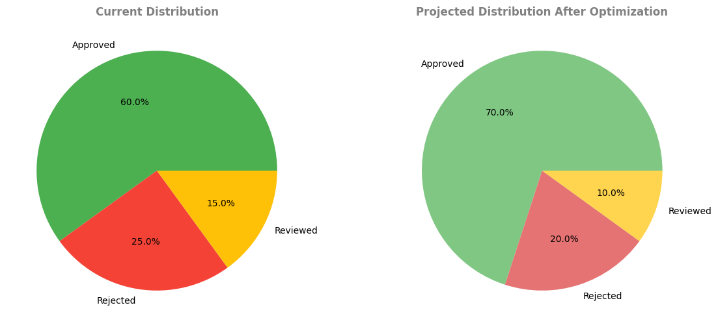
Pie Chart: Distribution of Loan Decision Categories

Slide 11
This chart shows the situation before and after implementing the proposed models:
Current State (Left Chart):About 60% of loans are approved, 25% are rejected, and 15% require review.
Post-Optimization (Right Chart): The approval rate is expected to reach 70%, while the need for manual review drops to just 10%. These changes are attributed to the models’ ability to enhance risk identification and opportunity detection.
Key Message: Reducing the number of loans requiring review optimizes operational processes and reduces decision-making time.

Slide 12
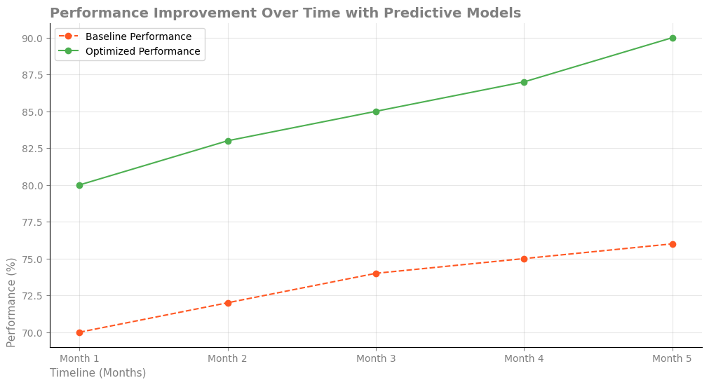
This chart illustrates the impact of new models over the next five months:
Current System Performance: Gradual, minimal increase from 70% to 76%.
Proposed System Performance: Significant growth from 80% to 90%.
Key Points: The proposed models yield higher returns in a shorter period, demonstrating their ability to quickly improve processes and decision-making transparency.
Key Message: The impact of these models grows over time, with substantial positive changes visible within a short period

Slide 13
Summary :
These three charts highlight a significant transformation in decision-making processes, reduced financial risks, improved prediction accuracy, and enhanced overall bank performance. It is recommended to implement these models promptly to maintain competitive advantages and minimize risks

Slide 14
Thanks
Thanks for your attention

